Slide 1
Unpaired Image Captioning via Scene Graph Alignments
Nanyang Technological University, Singapore
Monash University, Australia
ICCV2019

Slide 2
Problem
Most of current image captioning models heavily rely on paired image-caption datasets. However, getting large scale image-caption paired data is labor-intensive and time-consuming.
Unlike unsupervised neural machine translation where the encoders can be shared across the source and target languages, due to the different structures and characteristics of image and text modalities, the encoders of image and sentence cannot be shared to connect the two modalities.

Slide 3
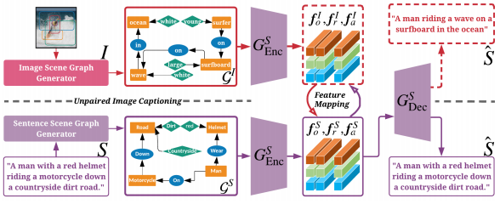

Overview
Notes:
We first extract the sentence scene graphs from the sentence corpus and train the scene graph encoder and the sentence decoder on the text modality. To align the scene graphs between images and sentences, we use CycleGAN [42] to build the data correspondence between the two modalities.

Slide 4
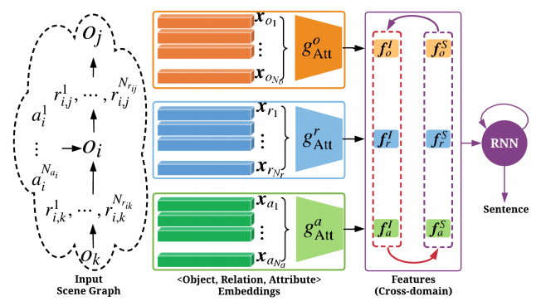

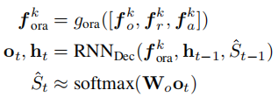
Sentence Decoder

Slide 5
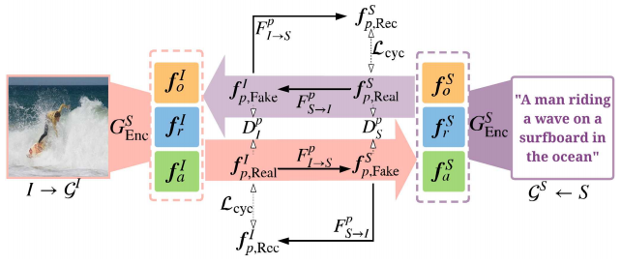
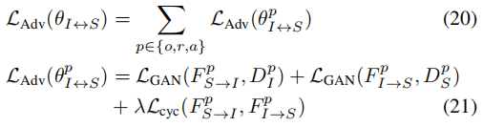

Train
First train the graph encoder and the sentence decoder in the text modality by the cross-entropy (XE) loss and RL
Unsupervised Mapping of Scene Graph Features
use CycleGAN to learn the feature alignment across domains.

Slide 6
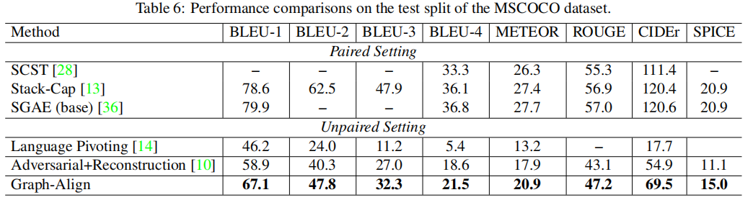
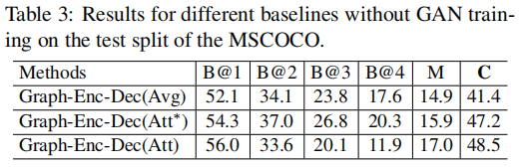
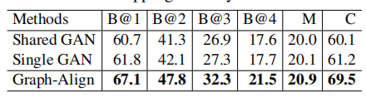
Results

Slide 7
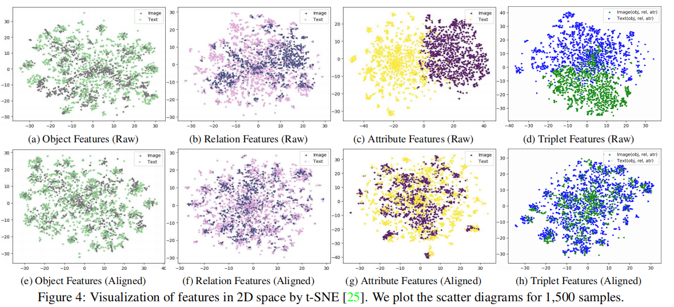
Results

